Slide 1
First 5
Expand the following
3(x+7)
x(x – 4)
(x+2)(x+5)
(x – 4)(x + 3)
2. Which of the expressions above are quadratic expressions?
3. A job can be completed in 8 hours by 5 people working equal amount of hours. How long would 3 people take to complete the same job?

Slide 2
Topic: Quadratics
EQ: How do I sketch a parabola with a table of values?

Slide 3
24
7
30
Topic: Quadratics
Date: 14/11/2018
EQ – How do I sketch a parabola with a table of values?

Slide 4



24
7
30
Topic: Quadratics
Date: 14/11/2018
EQ – How do I sketch a parabola with a table of values?
A quadratic equation has an x² as it’s highest power. When graphed it creates a shape called a parabola.
Examples are y =x² , y = 3x² + 2x + 6, y = -4x² - 5
1. To graph a parabola create a table with x values.
(I have used x= -3 to x= 3)
2. Substitute the x values into the equation to calculate y values
Eg. Graph the equation y = x²
x | -3 | -2 | -1 | 0 | 1 | 2 | 3
y
9
$$y= x^{2}$$
-3
$$y= {( )}^{2}$$
$$y= 9$$
Notes:
General Year 9: Demonstrate substitution for the remainder of the table to fill in the values.
Extension Year 9: Students should be able to complete the table without assistance.

Slide 5
24
7
30
Topic: Quadratics
Date: 14/11/2018
EQ – How do I sketch a parabola with a table of values?
The table with the calculated y-values looks like this.
Examples are y =x² , y = 3x² + 2x + 6, y = -4x² - 5
1. To graph a parabola create a table with x values.
(I have used x= -3 to x= 3)
2. Substitute the x values into the equation to calculate y values
y = x²
x | -3 | -2 | -1 | 0 | 1 | 2 | 3
y | 9 | 4 | 1 | 0 | 1 | 4 | 9
These values gives us the coordinates that we can graph.
(-3, 9)
Notes:
General Year 9 Class: Work together with the class to list all the co-ordinates.
Extension Year 9: Students should be able to determine the co-ordinates without assistance.

Slide 6
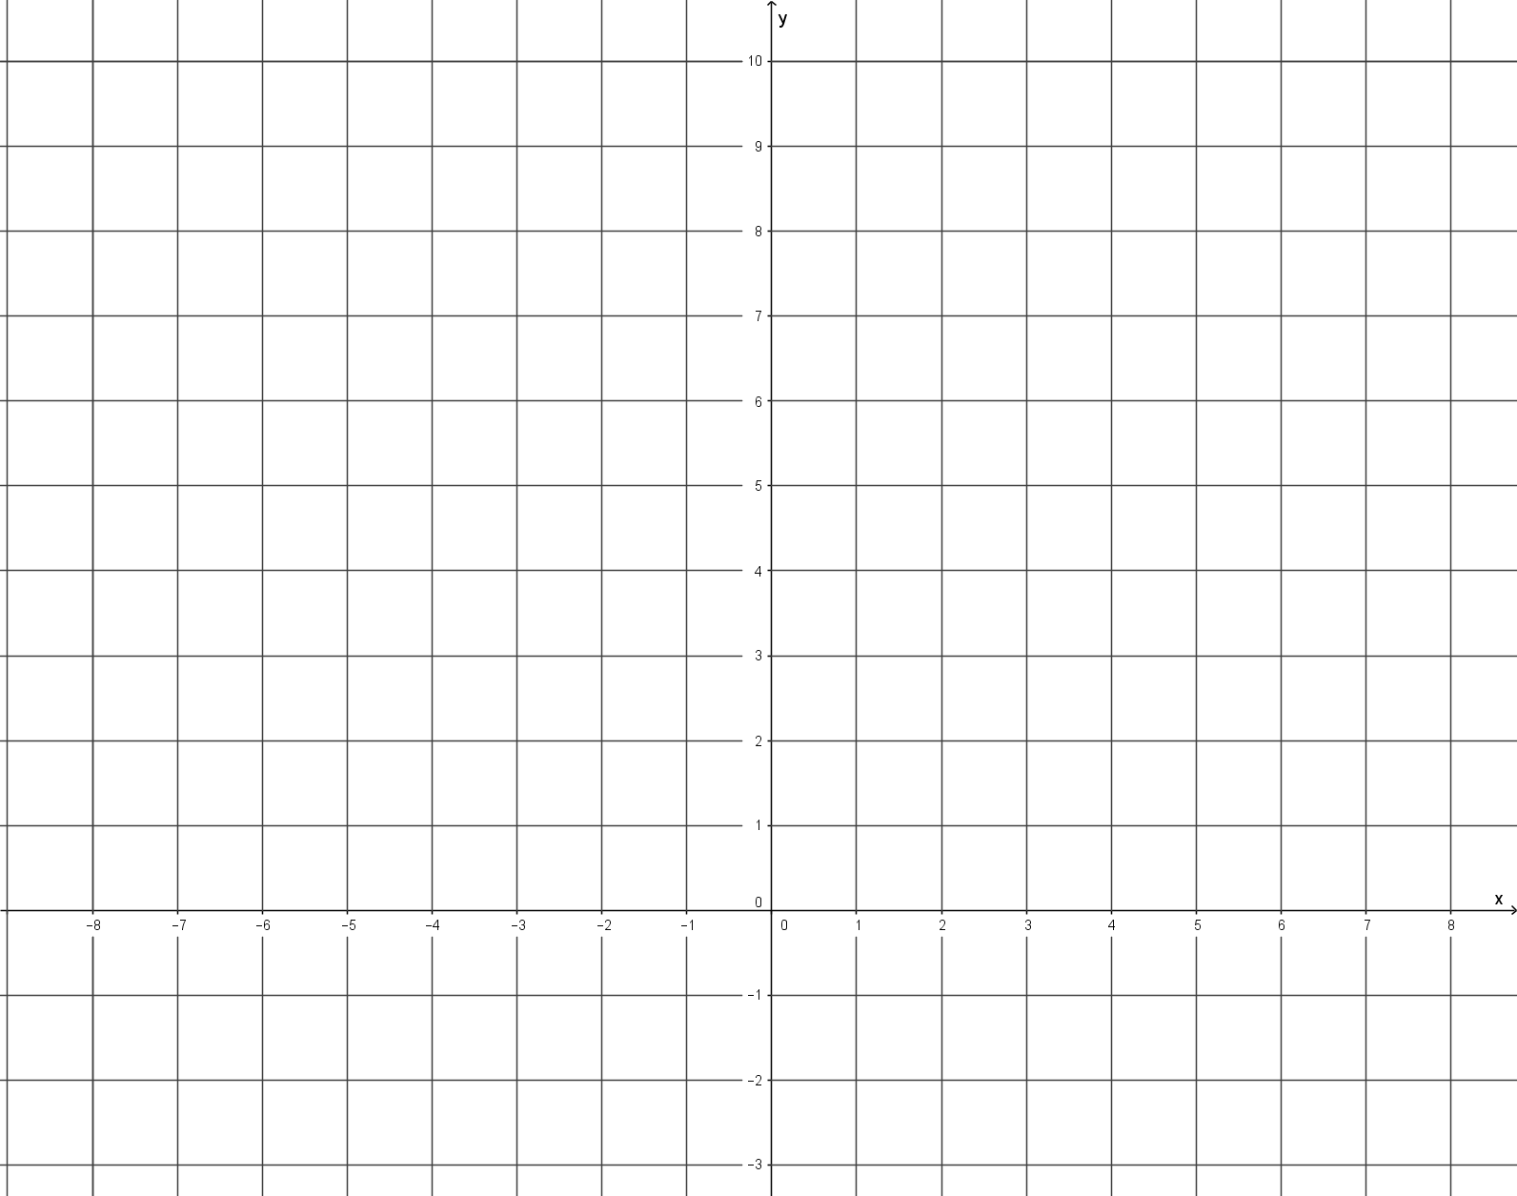
24
7
30
Topic: Quadratics
Date: 14/11/2018
EQ – How do I sketch a parabola with a table of values?
Graph the equation y = x²
1. To graph a parabola create a table with x values.
(I have used x= -3 to x= 3)
2. Substitute the x values into the equation to calculate y values
x | -3 | -2 | -1 | 0 | 1 | 2 | 3
y | 9 | 4 | 1 | 0 | 1 | 4 | 9
This gives us the coordinates that we can graph.
(-3, 9), (-2, 4), (-1, 1), (0, 0), (1, 1), (2, 4), (3, 9)
y
10
9
8
7
6
5
4
3
2
1
0
1
2
3
3. Plot the co-ordinates onto the cartesian plane.
4. Without using a ruler, join the dots to create a smooth curve.
x
-7 -6 -5 -4 -3 -2 -1 0 1 2 3 4 5 6 7
Notes:
General Year 9 Class: Work together with the class to plot the co-ordinates.
Extension Year 9: Students should be able to plot the co-ordinates without assistance.

Slide 7
TASK
Dwyer 9 Exercise 4.6, page 55

Slide 8
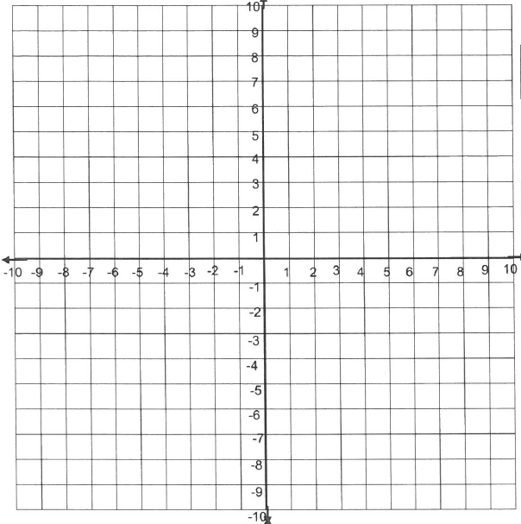
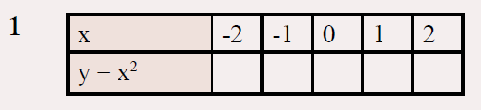
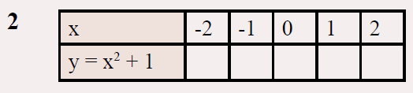
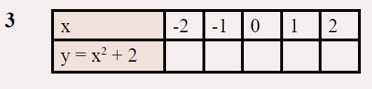

Slide 9
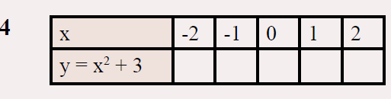
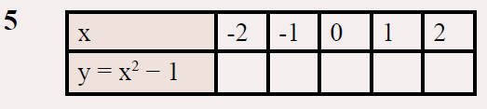
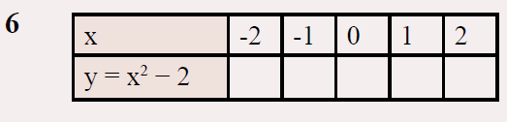

Slide 10
